Slide 1


Semi-Supervised Learning
with Ladder Networks
Group 2
Atefeh Mahdavi
Tapas Joshi
Chandan P. Patil

Slide 2
Problem
Training
How to tackle dataset with noise?
How to deal with corrupted dataset?

Slide 3
Different Types of Learning
Supervised Learning (completely training labeled data)
Unsupervised Learning (without any training labeled data)
Semi-Supervised Learning (A class of supervised learning tasks and techniques that makes use of unlabeled data for training)

Slide 4
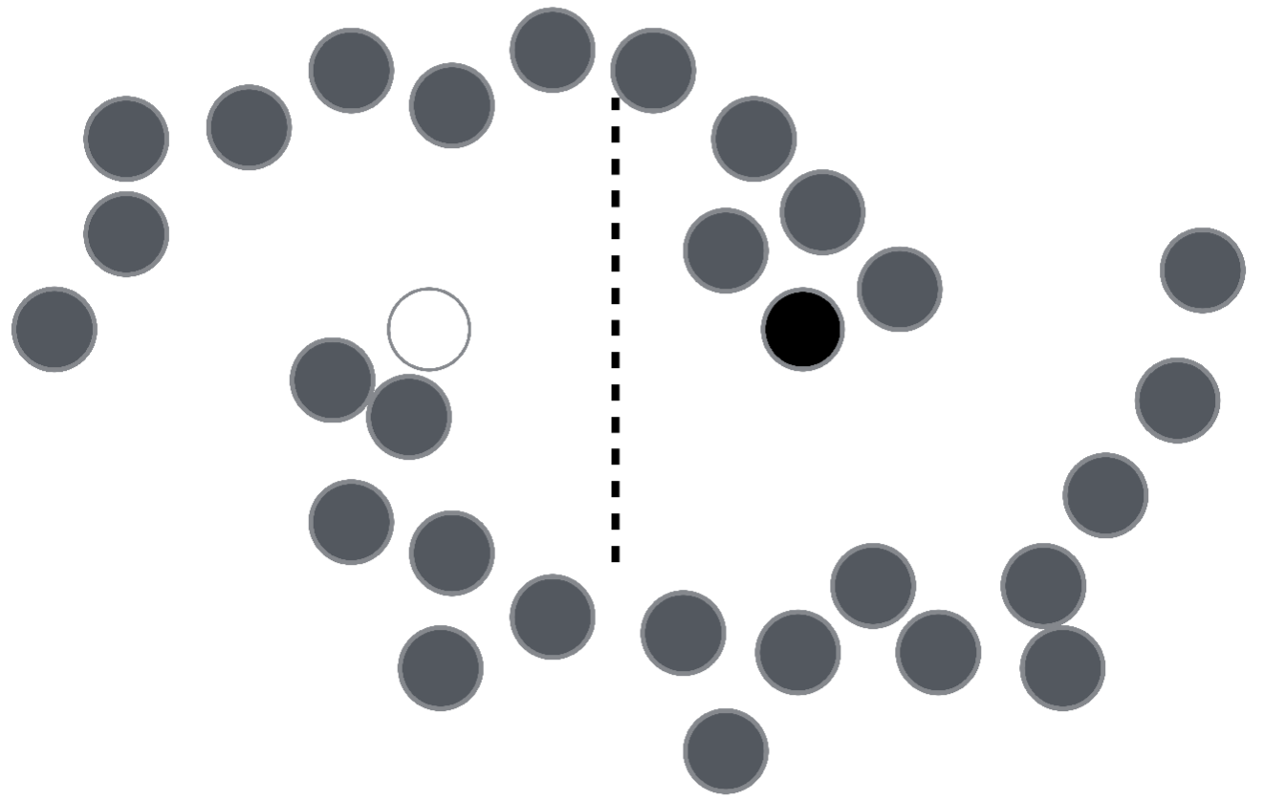
What if you see all the unlabeled data?
Semi-Supervised Learning with Ladder Networks

Slide 5
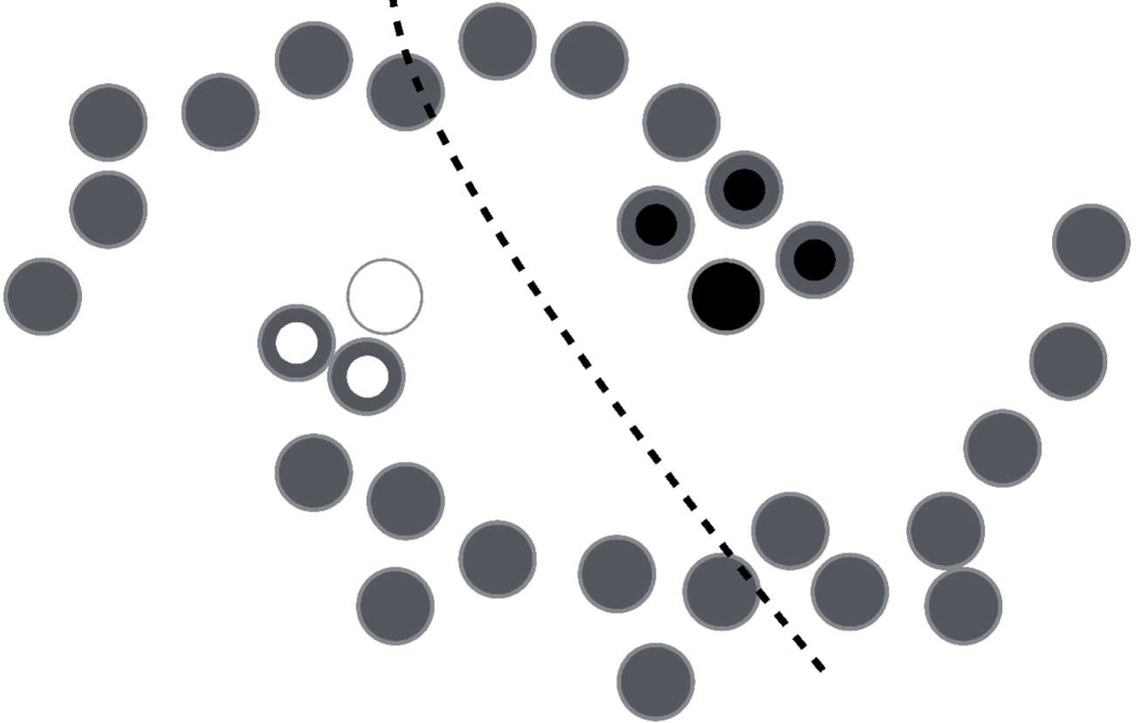
Labels are homogenous in densely populated space?

Slide 6
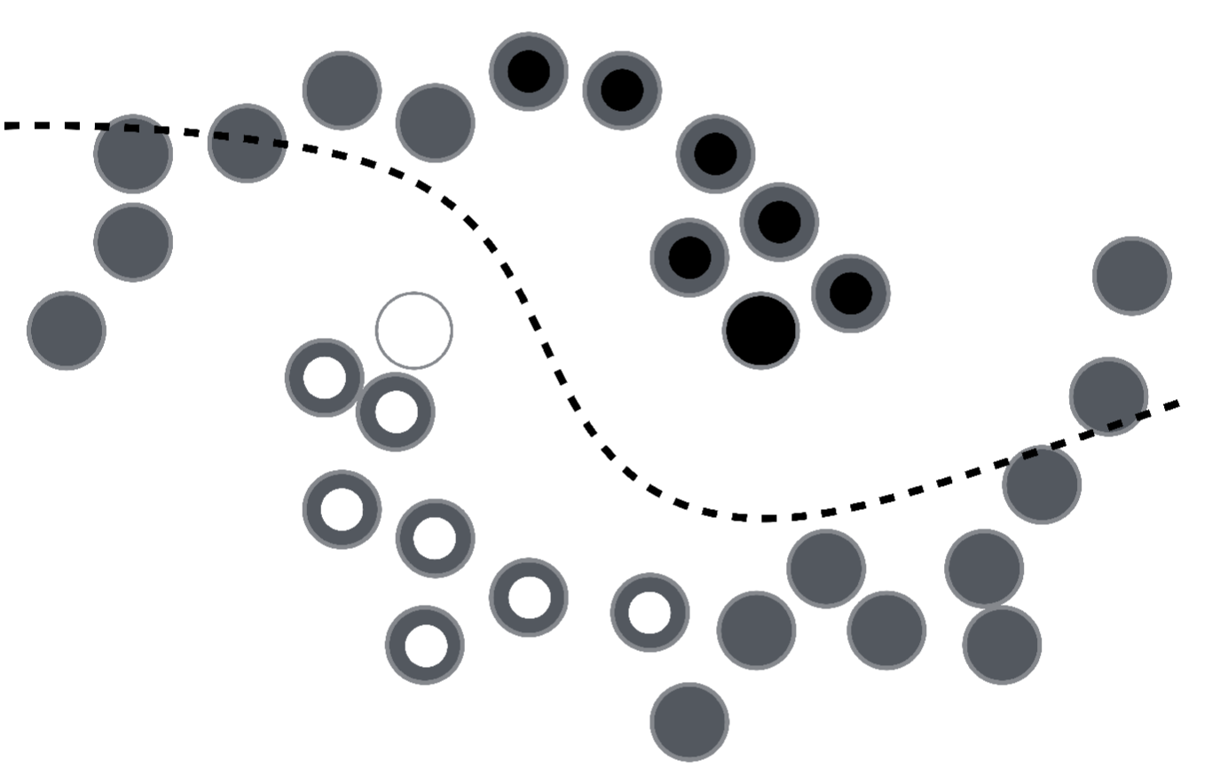
Labels are homogenous in densely populated space?

Slide 7
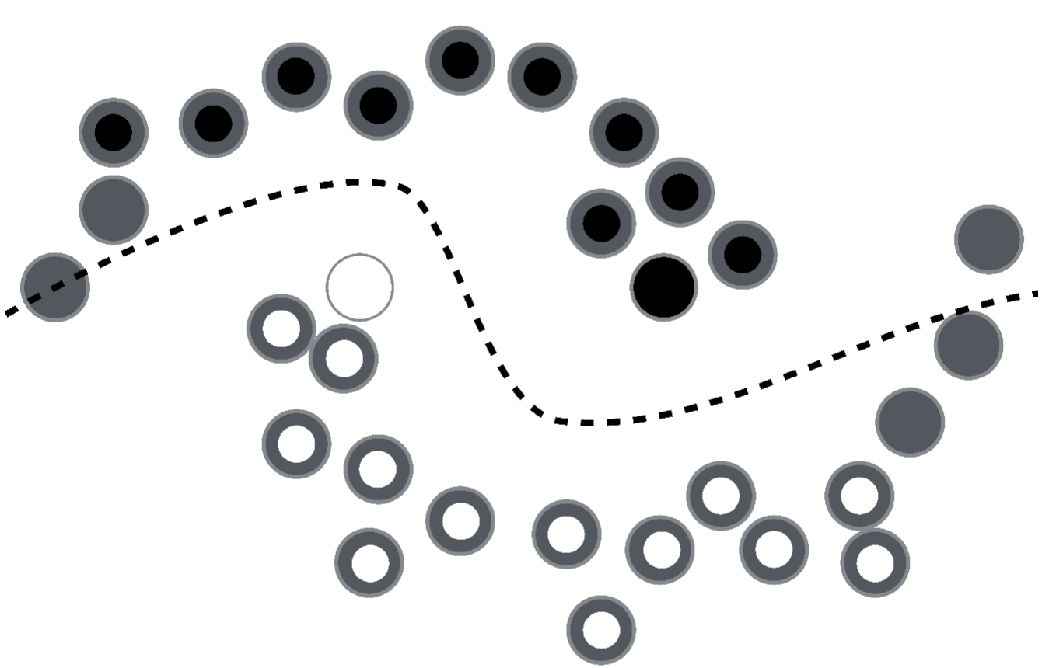
Labels are homogenous in densely populated space?

Slide 8
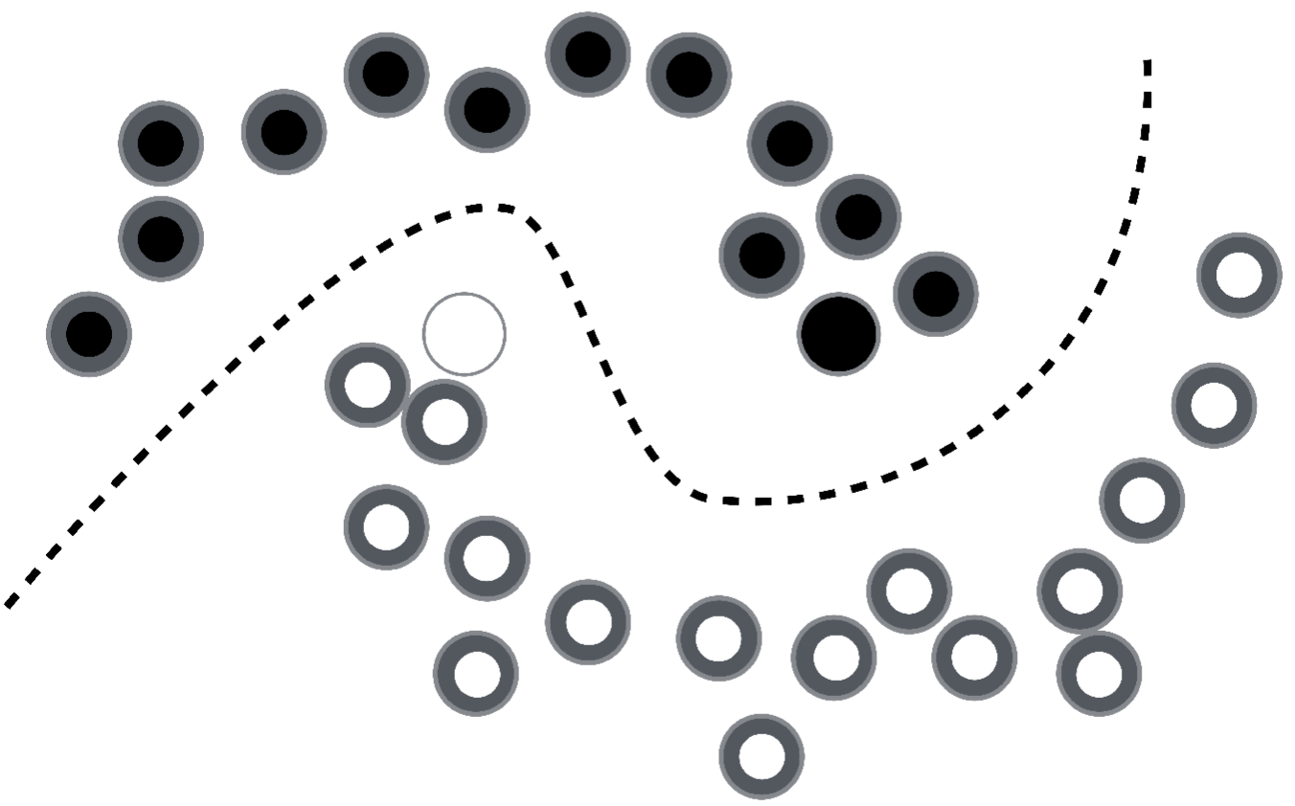
Labels are homogenous in densely populated space?

Slide 9
Ladder Networks:
Type of Recurrent Neural Networks
Encoder-Decoder Structure
Only for pre-training
Ladder Network: it is trained to minimize the cost by propagation
Ladder Network
Unsupervised
Supervised

Slide 10
Key-aspects of Ladder Networks
Compatible
Scalability
Computational efficiency

Slide 11
Encoder
adds Gaussian noise
Supervised cost: Output of corrupted encoder and the output target
Encoder
Clean Encoder
Corrupted Encoder

Slide 12
Decoder as Unsupervised Learning
Target Denoising Function
Unsupervised cost : Difference between the reconstruction and the clean version
Decoder
Clean Version
Corrupted Version

Slide 13
Final Cost
Final cost = Supervised Cost + Unsupervised Cost
Supervised cost – Output of corrupted encoder and the output target
Unsupervised cost – Sum of the denoising cost of all layers

Slide 14
Technical Implementation
Training
Labelled data: {x_{n}, t_{n}} 1 ≤ n ≤ N
Unlabelled data: {x_{n}} N+1 ≤ n ≤ M
Often labelled data is scarce, unlabelled data is plentiful:
N << M

Slide 15

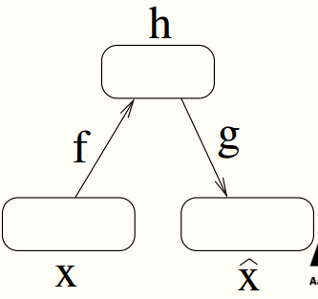
Technical Implementation
Corrupt input x_{t} with Gaussian noise to get _{t}
Encoder function f : x → h
Decoder function g : h →
Reconstruction

Slide 16
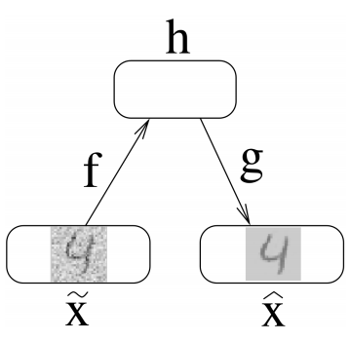
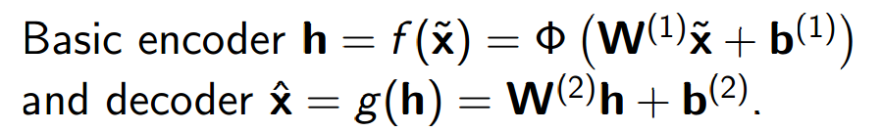
Denoising Autoencoder (DAE)
Reconstruction + Denoising
Reconstruction: Representation should be robust to the introduction of noise
Feeds corrupted inputs to x
Trains our function g(f(x)) to minimize reconstruction errors
Denoising
Source
Separation (DSS)

Slide 17
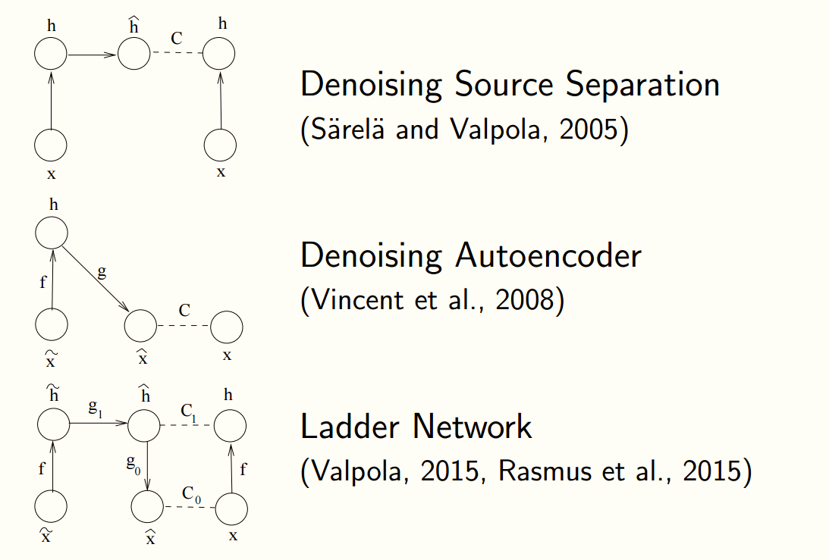
Combining DSS and DAE

Slide 18
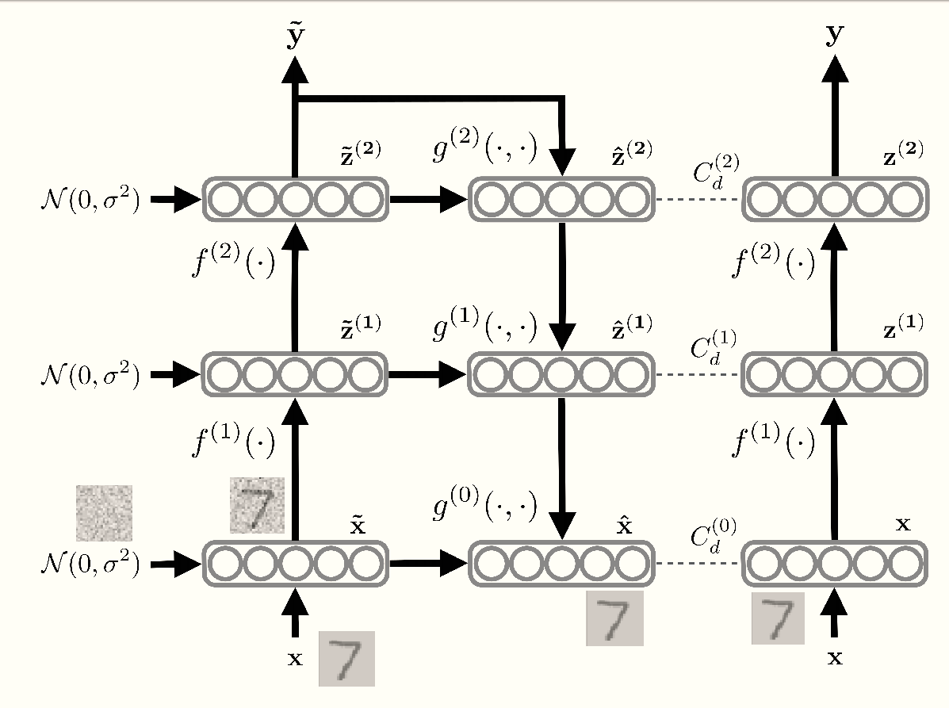
Ladder Network Architecture

Slide 19
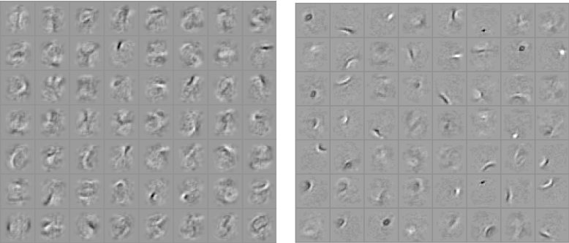
Analysis
Training a classifier (top), when you get the labels correct, learning stops. ⇒ Learned parameters are based on the information in labels: Less than #examples×#classes bits.
Training a denoising autoencoder (down), outputs are richer: #examples×#dimensions
Denoising models are much easier to train than probabilistic models as they are trainable by basic back-propagation.

Slide 20
Implementation
Python
Tensorflow
MNIST Dataset
60,000 Training + 10,000 Testing
100 images (Supervised – Labeled)
59,900 images (Unsupervised – Unlabeled)

Slide 21
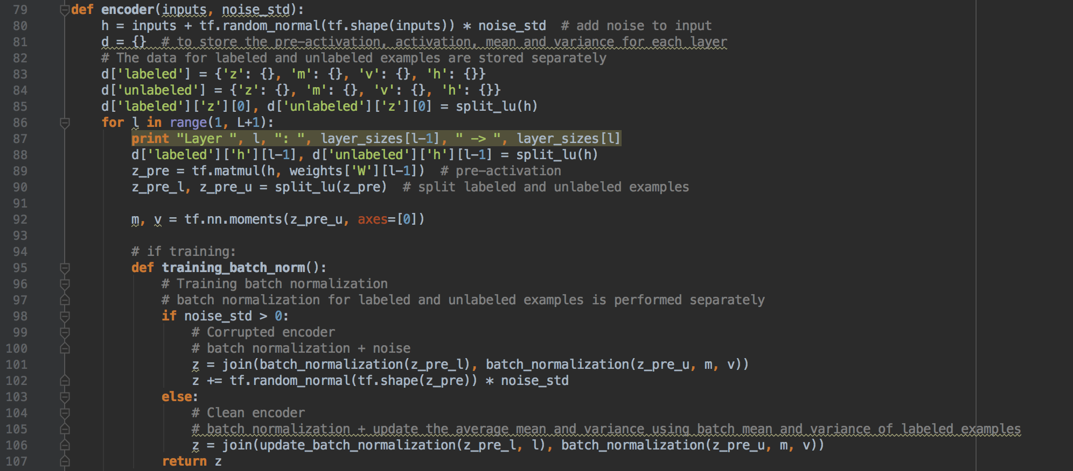
Code (Encoder)
https://github.com/Tapas-Joshi/AI-Ladder_Network

Slide 22
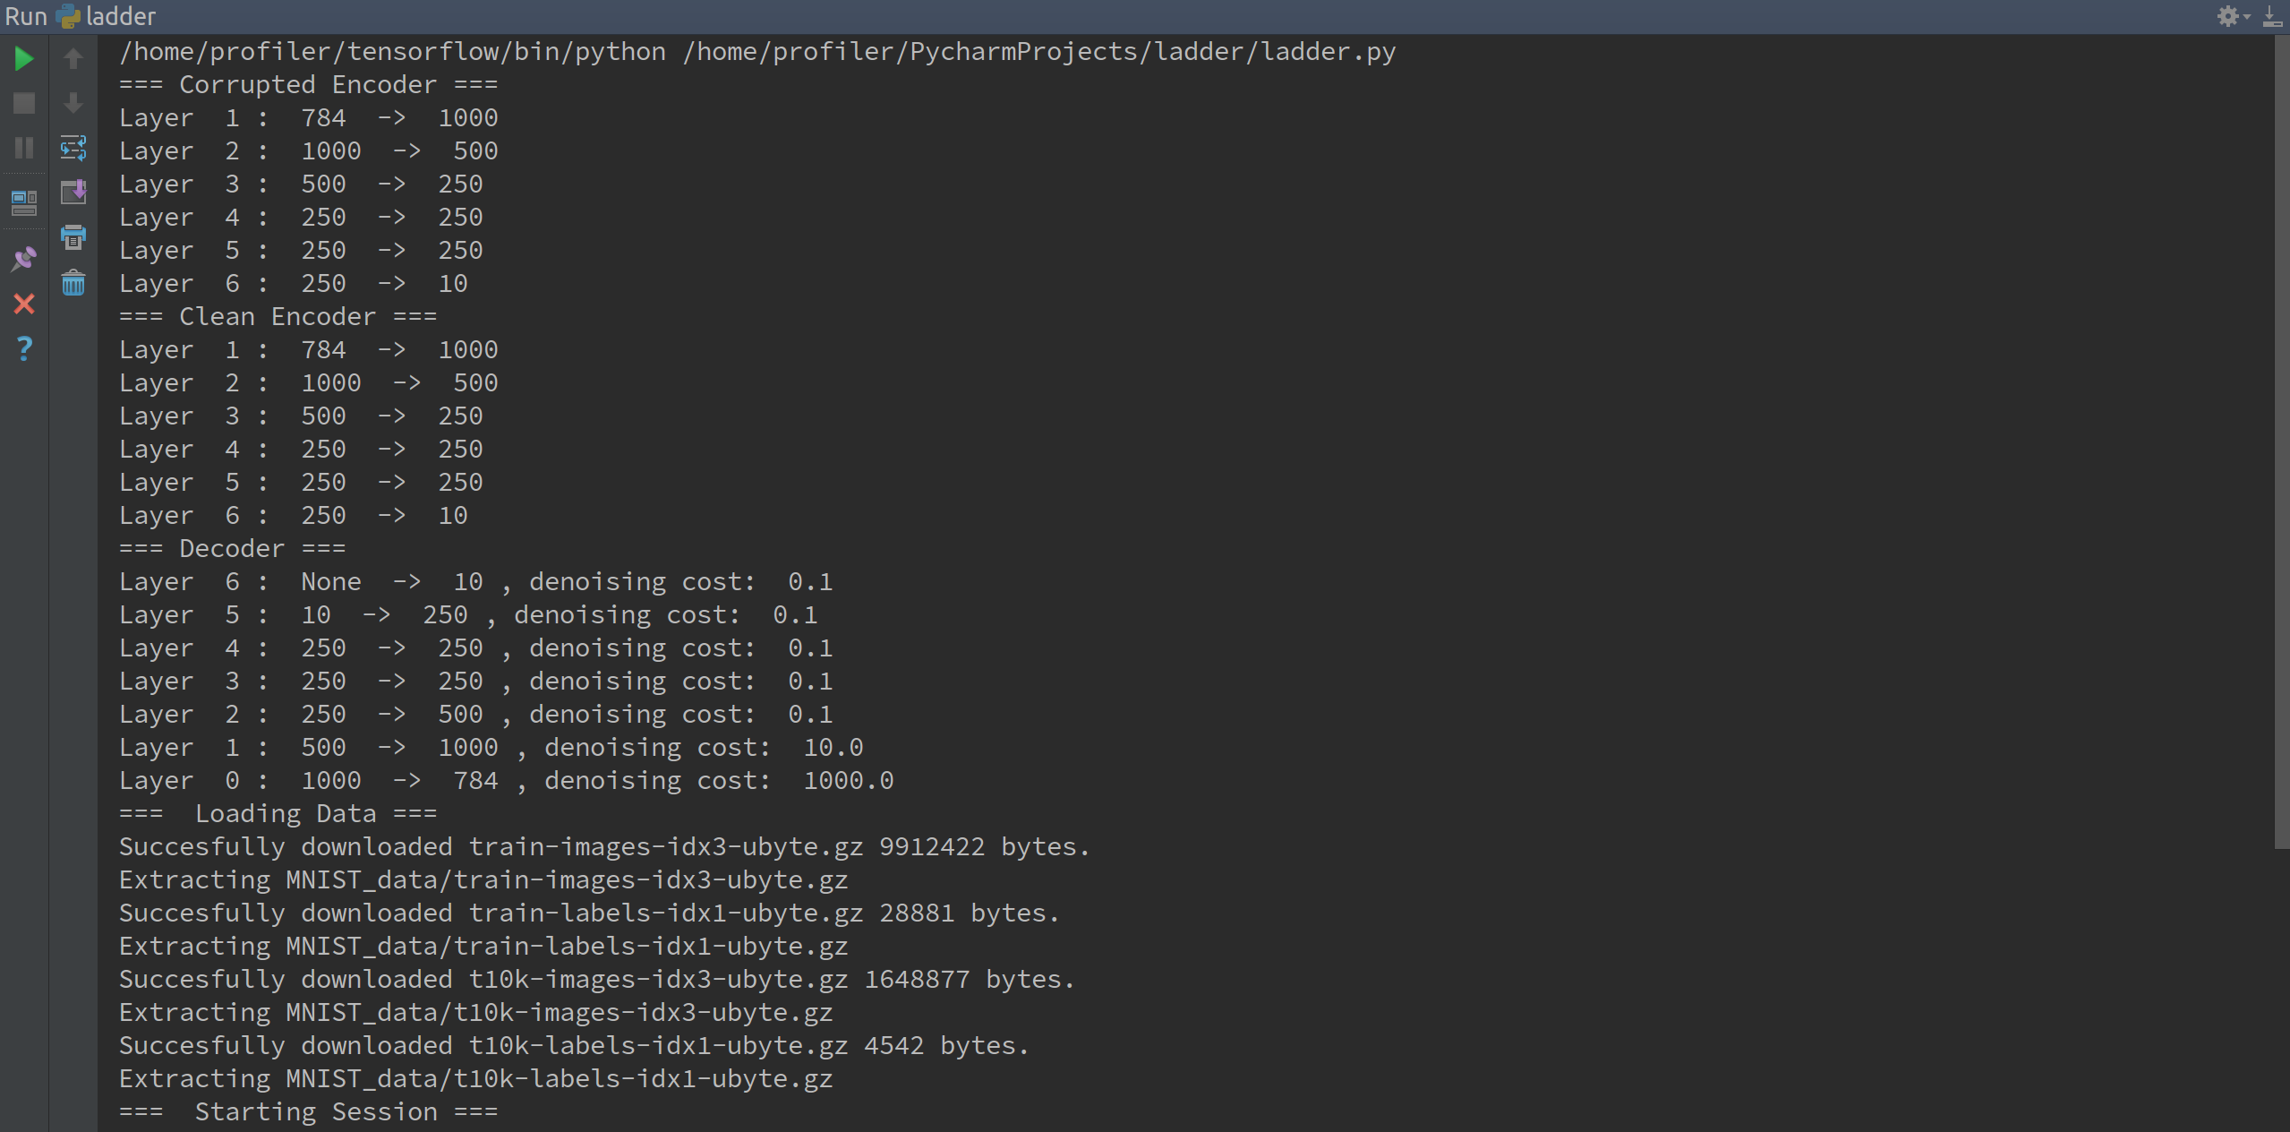
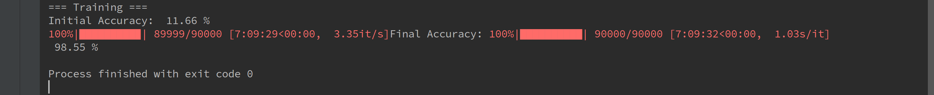
Code Output

Slide 23
Results – Accuracy Comparison

Slide 24
Results – Time Comparison
*CPU used was same, i7-4th Generation

Slide 25
Advantages
Quick to train
Scalability
Flexible
Efficient in terms of costs

Slide 26
Conclusion
Train the whole network using semi-supervised setting using the optimization techniques such as Gradient Descent to minimize cost
On MNIST the error rate for the Ladder network is Impressive with
1.45% for CPU
1.23 % for Nvidia 630M
1.1% for Nvidia 770

Slide 27
– LeCun, Bengio, Hinton, Nature 2015
THANKS
“We expect unsupervised learning to become far more important in the longer term. Human and animal learning is largely unsupervised: we discover the structure of the world by observing it, not by being told the name of every object.”

